Slide 1

FLIGHT PRICE PREDICTION PROJECT
JASMINE KAUR
FLIP ROBO TECHNOLOGIES
INTERNSHIP 18

Slide 2
PROBLEM STATEMENT
Anyone who has booked a flight ticket knows how unexpectedly the prices vary. The cheapest available ticket on a given flight gets more and less expensive over time. This usually happens as an attempt to maximize revenue based on –
1. Time of purchase patterns (making sure last-minute purchases are expensive)
2. Keeping the flight as full as they want it (raising prices on a flight which is filling up in order to reduce sales and hold back inventory for those expensive last-minute expensive purchases)

Slide 3
MOTIVATION
Collecting the data is one of the most important task in the process of building a project that predicts the price of flights.
There are various data sources that provides details of different routes, times, etc. on a daily basis. But the ability to bring those resources together and then to build a project that has the ability to predict the fares was exciting as well as challenging at the same time

Slide 4
UNDERSTANDING THE PROBLEM
This machine learning problem is characterized as supervised learning.
SUPERVISED LEARNING: In supervised learning, we are given a dataset along with the correct output , and thus we are able to find a relationship between input and output.
REGRESSION PROBLEM: As we dealing with continuous target variable, it means that our goal to map input variable to some continuous function. This is called regression problem.

Slide 5
BUSINESS GOAL
You are required to model the price of flights with the available independent variables.
This model will then be used by the management to understand how exactly the prices vary with the variables.
Further, the model will be a good way for the management to understand the pricing dynamics.

Slide 6
DATASET INFORMATION
As the target variable is a continuous variable, so it is a regression problem .
There are no null values in the data.
There is presence of outliers and skewness in the data.
Some of the features are of object data type while others are numerical.

Slide 7
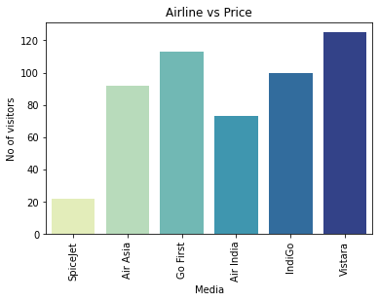
AIRLINE VS PRICE

Slide 8
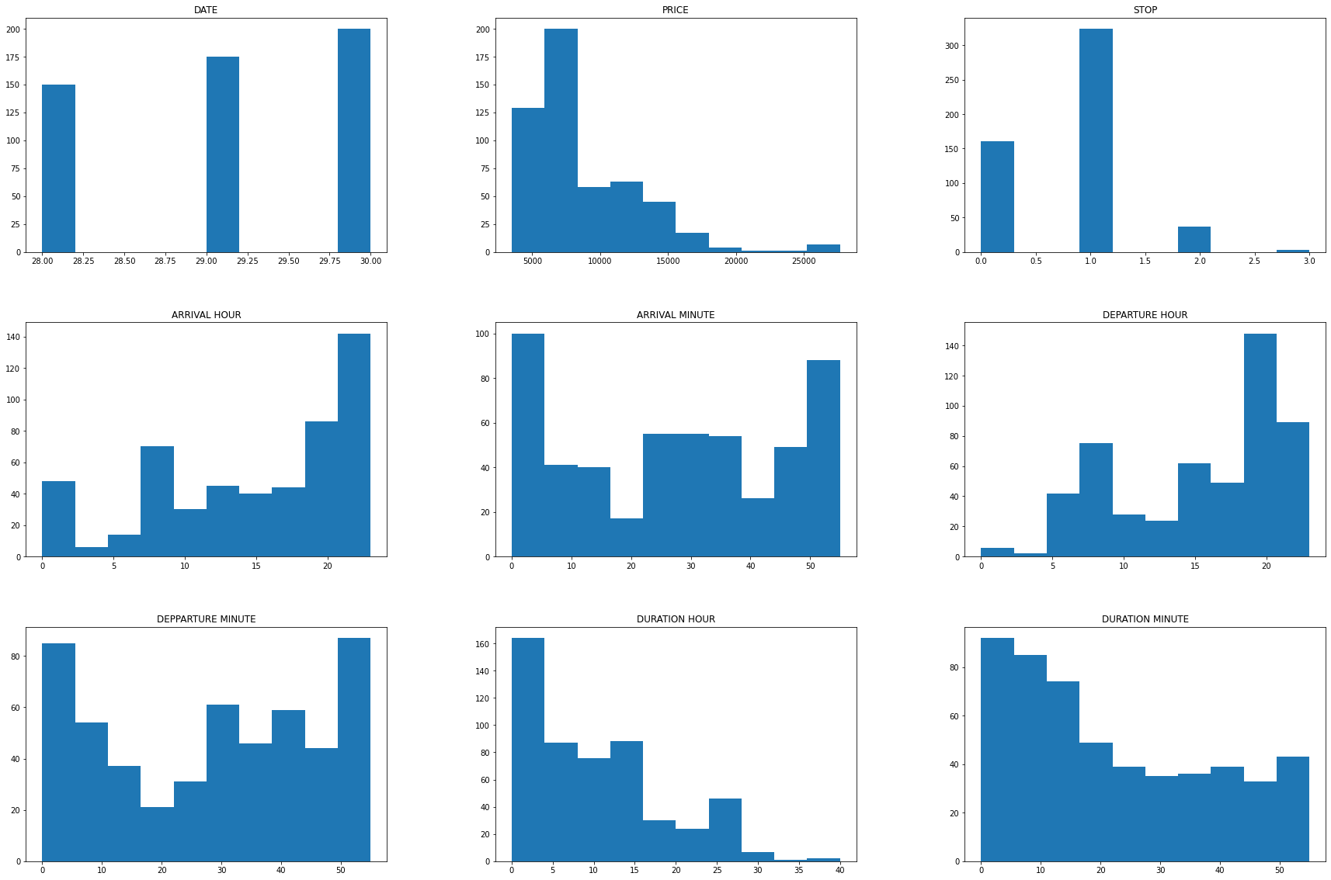
HISTOGRAM

Slide 9
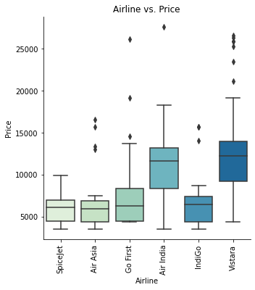
BOXPLOT

Slide 10
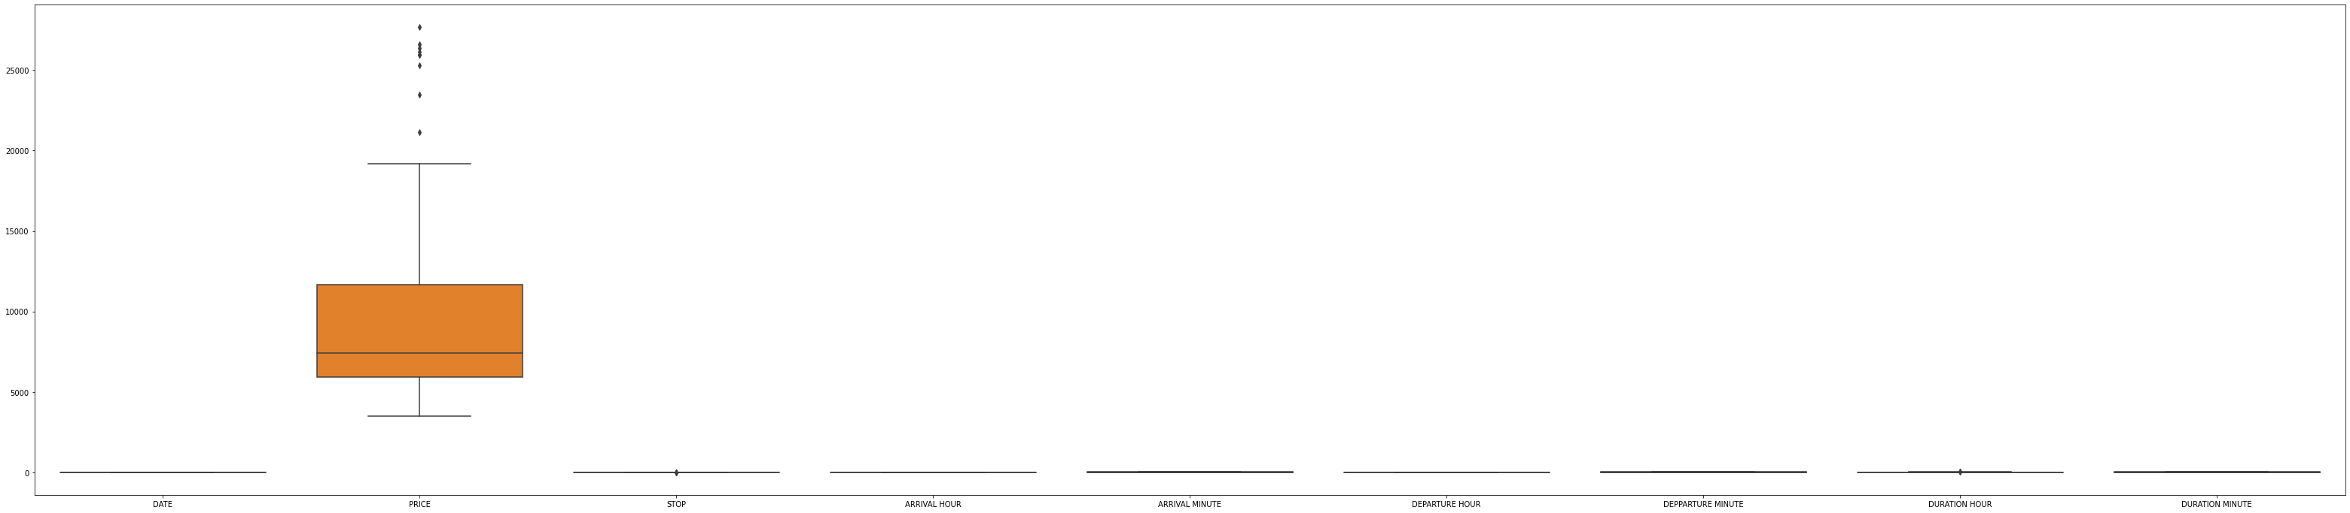
BOXPLOT

Slide 11
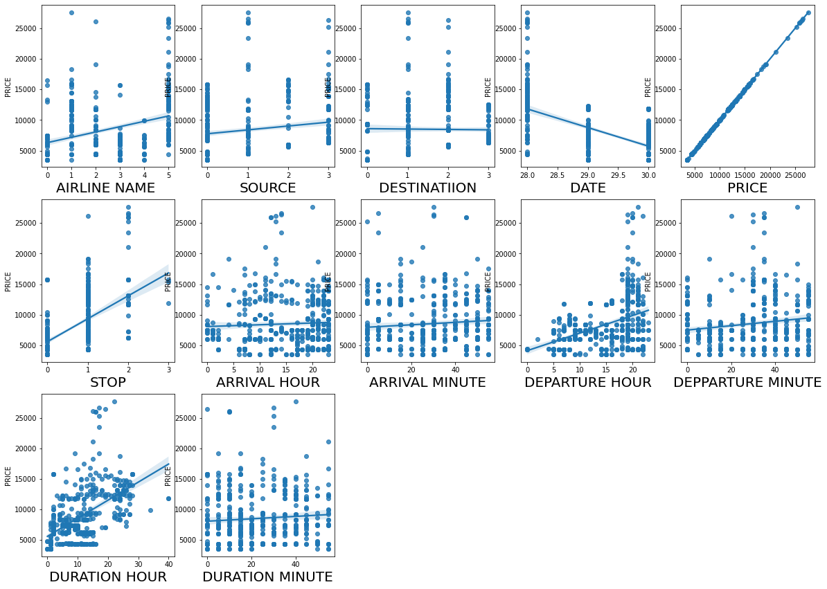
REGRESSION CURVES

Slide 12
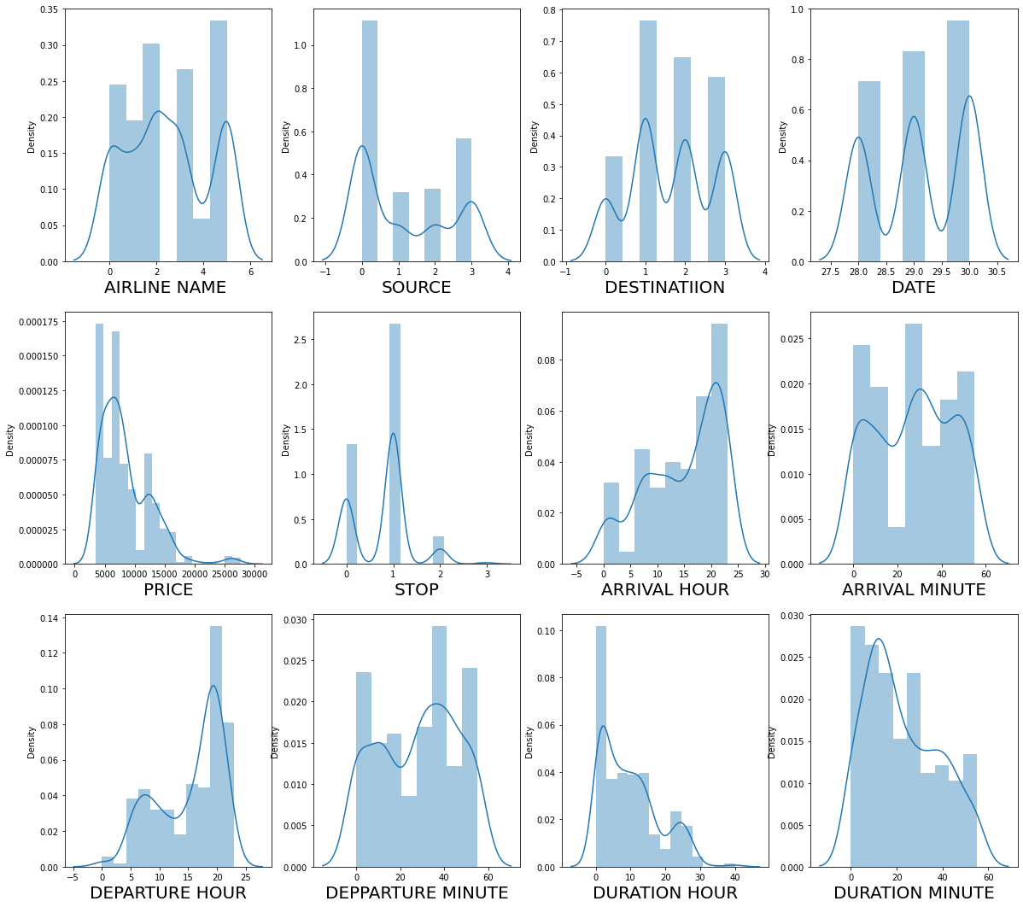
DISTRIBUTION GRAPHS

Slide 13
TOOLS USED
Hardware: 4 GB RAM, Intel 13 processor
Software:
Anaconda(64 bit)
Jupytor notebook
Python
MS-Office
Google Chrome Web Browser

Slide 14
REGRESSION ALGORITHM USED
Linear Regression
Random Forest Regressor
Kneighbors Regressor(n_neighbors = 4)
Gradient Boosting Regressor

Slide 15
EVALUATION
R2 SCORE(COEFFICIENT OF DETERMINATION): It is the proportion variation in the dependent variable that is predictable from the independent variables.
MEAN SQUARE ERROR(MSE): MSE calculates mean or average of the squared differences between predicted and expected target variable in a dataset.

Slide 16
INTERPRETATION OF RESULTS
After comparing the r2 score and the cross validation score, we have reached at a conclusion that the KNearest Neighbors Regressor is the best model.
We have applied hyperparameter tuning and then we have saved the model.

Slide 17
CONCLUSION
By using machine learning algorithm, we predicted the flight prices.
We did data cleaning, handled missing values, removed skewness, and applied regression algorithm.
The hyperparameter tuning is applied on the best model.

